Slide 1

4.8 MARIE
17
We can now bring together many of the ideas that we have discussed to this point using a very simple model computer.
Our model computer, the Machine Architecture that is Really Intuitive and Easy, MARIE, was designed to illustrate basic architecture concepts.
While this system is too simple to do anything useful in the real world, understanding its functions will make it easier to understand more complex system architectures.

Slide 2
4.8 MARIE
18
The MARIE architecture has the following characteristics:
  Binary, two's complement data representation.
  Stored program, fixed word length data and instructions.
  4K words of word-addressable main memory.
  16-bit data words.
  16-bit instructions, 4 for the opcode and 12 for the address.
  A 16-bit arithmetic logic unit (ALU).
  Seven registers for control and data movement.

Slide 3
4.8 MARIE
19
MARIE’s seven registers are:
  Accumulator, AC, a 16-bit register that holds a conditional operator (e.g., "less than") or one operand of a two-operand instruction.
  Memory address register, MAR, a 12-bit register that holds the memory address of an instruction or the operand of an instruction.
  Memory buffer register, MBR, a 16-bit register that holds the data after its retrieval from, or before its placement in memory.

Slide 4
4.8 MARIE
20
MARIE’s seven registers are (continued):
  Program counter, PC, a 12-bit register that holds the address of the next program instruction to be executed.
  Instruction register, IR, which holds an instruction immediately preceding its execution.
  Input register, InREG, an 8-bit register that holds data read from an input device.
  Output register, OutREG, an 8-bit register, that holds data that is ready for the output device.

Slide 5
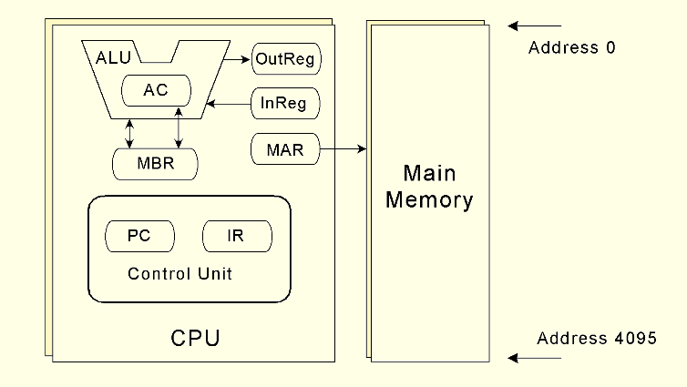
4.8 MARIE
21
This is the MARIE architecture shown graphically.

Slide 6
4.8 MARIE
22
The registers are interconnected, and connected with main memory through a common data bus.
Each device on the bus is identified by a unique number that is set on the control lines whenever that device is required to carry out an operation.
Separate connections are also provided between the accumulator and the memory buffer register, and the ALU and the accumulator and memory buffer register.
This permits data transfer between these devices without use of the main data bus.

Slide 7
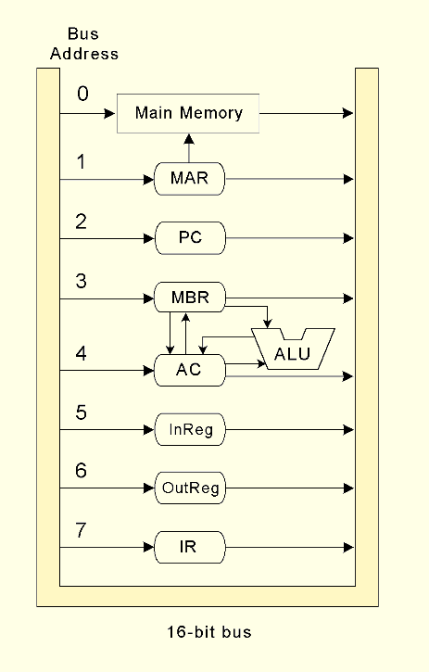
4.8 MARIE
23
This is the MARIE data path shown graphically.
All the bits of the control bus enter and leave each component.
The bus address on the diagram shows which bit configuration needs to be represented (e.g., 1 = 001,
2 = 010, etc.) in order for that component to know that it is being spoken to.

Slide 8
4.8 MARIE ISA
24
A computer’s instruction set architecture (ISA) specifies the format of its instructions and the primitive operations that the machine can perform.
The ISA is an interface between a computer’s hardware and its software.
Some ISAs include hundreds of different instructions for processing data and controlling program execution.
The MARIE ISA has only thirteen instructions.

Slide 9
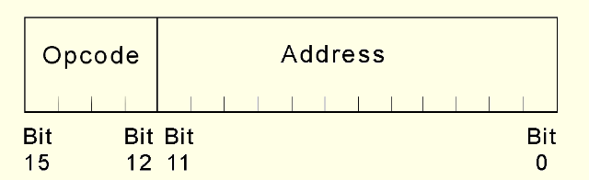
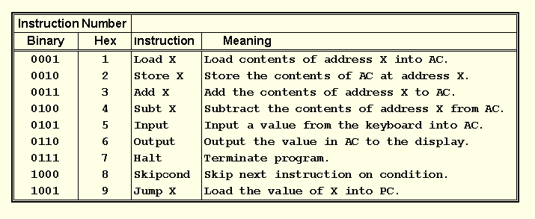
4.8 MARIE ISA
25
This is the format
of a MARIE instruction:
The fundamental MARIE instructions are:

Slide 10
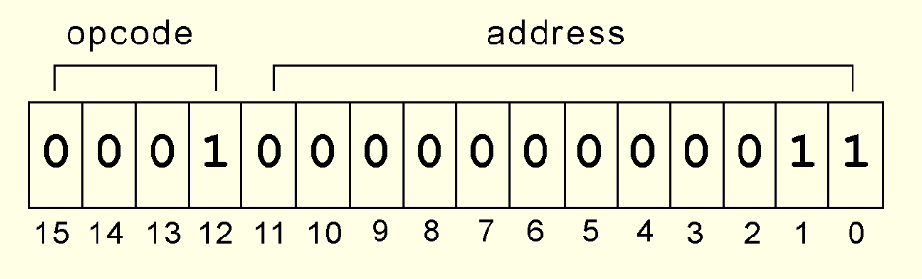
4.8 MARIE Instr. Layout
26
This is a bit pattern for a LOAD instruction as it would appear in the IR:
We see that the opcode is 1 and the address from which to load the data is 3.

Slide 11
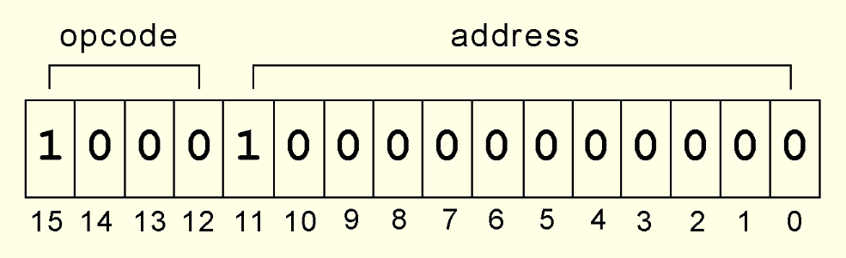
4.8 MARIE Instr. Layout
27
This is a bit pattern for a SKIPCOND instruction as it would appear in the IR:
We see that the opcode is 8 and bits 11 and 10 are 10, meaning that the next instruction will be skipped if the value in the AC is greater than zero.

Slide 12
4.8 MARIE RTL
28
Each of our instructions actually consists of a sequence of smaller instructions called microoperations.
The exact sequence of microoperations that are carried out by an instruction can be specified using register transfer language (RTL).
In the MARIE RTL, we use the notation M[X] to indicate the actual data value stored in memory location X, and ← to indicate the transfer of bytes to a register or memory location.

Slide 13
4.8 MARIE RTL
29
The RTL for the LOAD instruction is:
Similarly, the RTL for the ADD instruction is:
MAR ← X
MBR ← M[MAR]
AC ← MBR
MAR ← X
MBR ← M[MAR]
AC ← AC + MBR

Slide 14
4.8 MARIE RTL
30
Recall that SKIPCOND skips the next instruction according to the value of the AC.
The RTL for the this instruction is the most complex in our instruction set:
If IR[11 - 10] = 00 then
If AC < 0 then PC ← PC + 1
else If IR[11 - 10] = 01 then
If AC = 0 then PC ← PC + 1
else If IR[11 - 10] = 10 then
If AC > 0 then PC ← PC + 1

